Slide 1
Genetic Algorithms
CS121 Spring 2009
Richard Frankel
Stanford University

Slide 2
Outline
Motivations/applicable situations
What are genetic algorithms?
Pros and cons
Examples

Slide 3
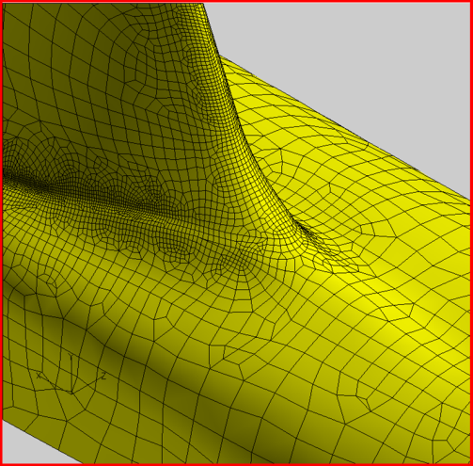
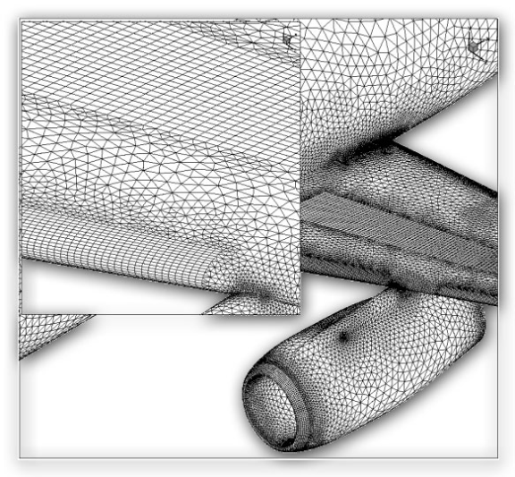
Motivation
Searching some search spaces with traditional search methods would be intractable. This is often true when states/candidate solutions have a large number of successors.
  Example: Designing the surface of an aircraft.
Image source: http://www.centaursoft.com/cms/index.php?section=25
Notes:
Images from http://www.centaursoft.com/cms/index.php?section=25

Slide 4
Applicable situations
Often used for optimization (scheduling, design, etc.) problems, though can be used for many other things as well, as we’ll see a bit later.
  Good problem for GA: Scheduling air traffic
  Bad problems for GA: Finding large primes (why?), 2D pathfinding (why?)
Notes:
Finding large primes is a bad problem for GA because the fitness landscape is not continuous – hard to differentiate between something 1 bit away from a prime, and something that is the complement of a prime.
2D pathfinding bad because the search space is small, so better off with A*.

Slide 5
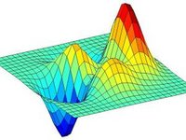
Applicable situations
Genetic algorithms work best when the “fitness landscape” is continuous (in some dimensions). This is also true of standard search, e.g. A*.
  Intuitively, this just means that we can find a heuristic that gives a rough idea of how close a candidate is to being a solution.
Image source: scholarpedia.org

Slide 6
So what is a genetic algorithm?
Genetic algorithms are a randomized heuristic search strategy.
Basic idea: Simulate natural selection, where the population is composed of candidate solutions.
Focus is on evolving a population from which strong and diverse candidates can emerge via mutation and crossover (mating).

Slide 7
Basic algorithm
Create an initial population, either random or “blank”.
While the best candidate so far is not a solution:
  Create new population using successor functions.
  Evaluate the fitness of each candidate in the population.
Return the best candidate found.

Slide 8
Simple example – alternating string
Let’s try to evolve a length 4 alternating string
Initial population: C1=1000, C2=0011
We roll the dice and end up creating C1’ = cross (C1, C2) = 1011 and C2’ = cross (C1, C1) = 1000.
We mutate C1’ and the fourth bit flips, giving 1010. We mutate C2’ and get 1000.
We run our solution test on each. C1’ is a solution, so we return it and are done.

Slide 9
Basic components
Candidate representation
  Important to choose this well. More work here means less work on the successor functions.
Successor function(s)
  Mutation, crossover
Fitness function
Solution test
Some parameters
  Population size
  Generation limit

Slide 10
Candidate representation
We want to encode candidates in a way that makes mutation and crossover easy.
The typical candidate representation is a binary string. This string can be thought of as the genetic code of a candidate – thus the term “genetic algorithm”!
  Other representations are possible, but they make crossover and mutation harder.

Slide 11
Candidate representation example
Let’s say we want to represent a rule for classifying bikes as mountain bikes or hybrid, based on these attributes*:
  Make (Bridgestone, Cannondale, Nishiki, or Gary Fisher)
  Tire type (knobby, treads)
  Handlebar type (straight, curved)
  Water bottle holder (Boolean)
We can encode a rule as a binary string, where each bit represents whether a value is accepted.
Make Tires Handlebars Water bottle
B
C
N
G
K
T
S
C
Y
N
*Bikes scheme used with permission from Mark Maloof.

Slide 12
Candidate representation example
The candidate will be a bit string of length 10, because we have 10 possible attribute values.
Let’s say we want a rule that will match any bike that is made by Bridgestone or Cannondale, has treaded tires, and has straight handlebars. This rule could be represented as 1100011011:
Make Tires Handlebars Water bottle
1
1
0
0
0
1
1
0
1
1
B
C
N
G
K
T
S
C
Y
N

Slide 13
Successor functions
Mutation – Given a candidate, return a slightly different candidate.
Crossover – Given two candidates, produce one that has elements of each.
We don’t always generate a successor for each candidate. Rather, we generate a successor population based on the candidates in the current population, weighted by fitness.

Slide 14
Successor functions
If your candidate representation is just a binary string, then these are easy:
  Mutate(c): Copy c as c’. For each bit b in c’, flip b with probability p. Return c’.
  Cross (c1, c2): Create a candidate c such that c[i] = c1[i] if i % 2 = 0, c[i] = c2[i] otherwise. Return c.
    Alternatively, any other scheme such that c gets roughly equal information from c1 and c2.

Slide 15
Fitness function
The fitness function is analogous to a heuristic that estimates how close a candidate is to being a solution.
In general, the fitness function should be consistent for better performance. However, even if it is, there are no guarantees. This is a probabilistic algorithm!
In our classification rule example, one possible fitness function would be information gain over training data.

Slide 16
Solution test
Given a candidate, return whether the candidate is a solution.
Often just answers the question “does the candidate satisfy some set of constraints?”
Optional! Sometimes you just want to do the best you can in a given number of generations, e.g. the classification rule example.

Slide 17
New population generation
How do we come up with a new population?
  Given a population P, generate P’ by performing crossover |P| times, each time selecting candidates with probability proportional to their fitness.
  Get P’’ by mutating each candidate in P’.
  Return P’’.
Notes:
Mutation is necessary because some important gene might be missing from all of the initial population.

Slide 18
New population generation
That was just one approach – be creative!
  That approach doesn’t explicitly allow candidates to survive more than one generation – this might not be optimal.
  Crossover is not necessary, though it can be helpful in escaping local maxima. Mutation is necessary (why?).
Notes:
Mutation is necessary because some important gene might be missing from all of the initial population.

Slide 19
Basic algorithm (recap)
Create an initial population, either random or “blank”.
While the best candidate so far is not a solution:
  Create new population using successor functions.
  Evaluate the fitness of each candidate in the population.
Return the best candidate found.

Slide 20
Pros and Cons
Pros
  Faster (and lower memory requirements) than searching a very large search space.
  Easy, in that if your candidate representation and fitness function are correct, a solution can be found without any explicit analytical work.
Cons
  Randomized – not optimal or even complete.
  Can get stuck on local maxima, though crossover can help mitigate this.
  It can be hard to work out how best to represent a candidate as a bit string (or otherwise).

Slide 21
Examples - GA in the wild
Rule set classifier generation
I tried this as an undergrad, and it worked pretty well. Rather than classifying bikes, I was classifying Congressional representatives by party, based on their voting records.
General approach:
  Use GA to generate a rule for training data, with information gain for the fitness function and no solution test (just a generation limit).
  Remove positive examples covered by the rule.
  Repeat the above two steps until all positive training examples are covered.
  To classify an example: iff the example is matched by any of the rules generated, consider it a positive example.

Slide 22
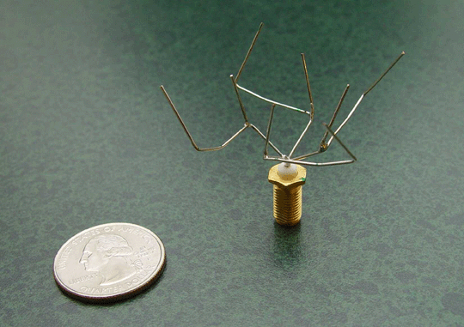
Examples - GA in the wild
ST5 Antenna – NASA Evolvable Systems Group
http://ti.arc.nasa.gov/projects/esg/research/antenna.htm

Slide 23
ST5 Antenna
Needs less power than standard antennae.
Doesn’t require a matching network nor a phasing circuit – two less steps in design and fabrication.
More uniform coverage than standard antennae, yielding more reliable performance.
Short design cycle – 3 person-months to prototype fabrication, vs. 5-person months on average for conventionally designed antennae.
Notes:
First, there is the potential of needing less power. Antenna ST5-3-10 achieves high gain (2-4dB) across a wider range of elevation angles. This allows a broader range of angles over which maximum data throughput can be achieved. Also, less power from the solar array and batteries may be required.
Second, the evolved antenna does not require a matching network nor a phasing circuit, removing two steps in design and fabrication of the antenna. A trivial transmission line may be used for the match on the flight antenna, but simulation results suggest that one is not required.
Third, the evolved antenna has more uniform coverage in that it has a uniform pattern with small ripples in the elevations of greatest interest (between 40 and 80 degrees). This allows for reliable performance as elevation angle relative to the ground changes.
Finally, the evolved antenna had a shorter design cycle. It was estimated that antenna ST5-3-10 took 3 person-months to design and fabricate the first prototype as compared to 5 person-months for the conventionally designed antenna.

Slide 24
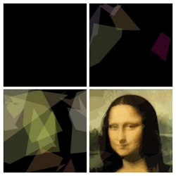
Examples - GA in the wild
Image compression – evolving the Mona Lisa
Generation 1
Generation 301
Generation 2716
Generation 904314
http://rogeralsing.com/2008/12/07/genetic-programming-evolution-of-mona-lisa/
Notes:
This weekend I decided to play around a bit with genetic programming and put evolution to the test, the test of fine art :-)
I created a small program that keeps a string of DNA for polygon rendering. The procedure of the program is quite simple:
0) Setup a random DNA string (application start)
Copy the current DNA sequence and mutate it slightly
Use the new DNA to render polygons onto a canvas
Compare the canvas to the source image
If the new painting looks more like the source image than the previous painting did, then overwrite the current DNA with the new DNA
repeat from 1
Now to the interesting part :-)
Could you paint a replica of the Mona Lisa using only 50 semi transparent polygons?
Took 904314 generations, though began to be recognizable as the Mona Lisa after 10,000 or so. Images above are generation 1, 301, 2716, and 904314.

Slide 25
Evolving the Mona Lisa
Uses only 50 polygons of 6 vertices each.
Population size of 1, no crossover – parent compared with child, and superior image kept.
Assuming each polygon has 4 bytes for color (RGBA) and 2 bytes for each of 6 vertices, this image only requires 800 bytes.
However, compression time is prohibitive and storage is cheaper than processing time. ☹

Slide 26
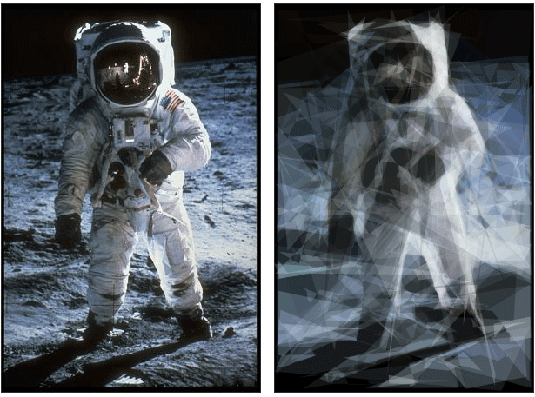
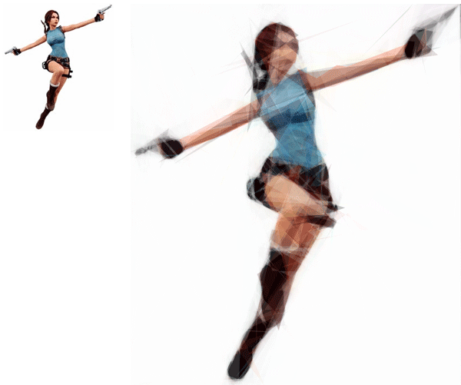
More evolved images
http://rogeralsing.com/2008/12/07/genetic-programming-evolution-of-mona-lisa/

